Slide 1
DATA STRUCTURES AND ALGORITHM
PROJECT TITLE: SHORTEST METRO ROUTE FINDER

Slide 2
PRESENTED BY
RA2211003010684:
RISHITA RAINA
RA2211003010686:
VIJAY MAKKAd
RA2211003010690:
HARSH TIWARI

Slide 3
ABSTRACT
The "Shortest Metro Route Finder Project in C" is a software application designed to help users navigate through a metro or subway system by identifying and providing the shortest route between two specified stations. This project aims to simplify the process of finding the quickest way to travel within a metro network, making it particularly useful for commuters and tourists. It involves the implementation of data structures and algorithms to calculate and display the most efficient route and a user-friendly interface to interact with the system. The primary goal of this project is to enhance the convenience and efficiency of metro travel for users.

Slide 4
PROBLEM STATEMENT
Urban metro systems are becoming increasingly complex, with numerous stations, multiple lines, and various interconnections. Navigating these metro systems efficiently can be challenging for both daily commuters and tourists. The problem is to develop a Metro Route Finder application to simplify the process of finding the shortest and most efficient routes between metro stations, catering to the needs of users with different preferences.

Slide 5
OBJECTIVES
The objectives of the "Shortest Metro Route Finder Project in C" include:
Route Optimization: Develop an algorithm that calculates the shortest and most efficient route between two metro stations, reducing travel time for users.
User-Friendly Interface: Create an intuitive and easy-to-use graphical user interface (GUI) that allows users to input their origin and destination stations and receive route information.
Data Representation: Implement data structures to represent metro stations, lines, and connectivity to facilitate route calculations.
Real-Time Updates: If feasible, incorporate real-time data to consider current conditions, such as delays or closures, when suggesting routes.
Customization: Allow users to customize their preferences, such as minimizing transfers or taking specific lines, to find routes that best suit their needs.

Slide 6
6. Error Handling: Handle invalid inputs, such as non-existent stations or non-connected routes, with informative error messages.
7. Efficiency: Optimize the algorithm for route finding to ensure quick response times, especially in large metro networks.
8. User Assistance: Provide additional information about the selected route, including station names, line changes, and estimated travel time.
9. Cross-Platform Compatibility: Develop the application to run on multiple platforms, such as Windows, macOS, and Linux, if possible.
10. Documentation and Testing: Create comprehensive documentation for users and developers, and conduct thorough testing to ensure the reliability and accuracy of the system.
11. Scalability: Design the system with the potential for expansion to include additional metro networks or transportation systems.

Slide 7
COMPONENTS OF THE PROJECT
THERE ARE 3 MAJOR COMPONENTS IN THIS PROJECT:
DATA STRUCTURES
ALGORITHM
USER INTERFACE

Slide 8
COMPONENTS
DATA STRUCTURES
ALGORITHM
USER INTERFACE
The weighted adjacency matrix graph[25][25] represents the metro network. It holds the distances (weights) between metro stations. However, this implementation only represents distances between stations and does not include station names or additional station information. To create a comprehensive Metro Route Finder, additional data structures for station names, station details, and user data may be required.
Dijkstra's algorithm is used to find the shortest route between metro stations. The dijkstra function implements this algorithm. It calculates the shortest path from a source station to all other stations in the network, taking into account the weights (distances) stored in the graph matrix.
The code contains a basic console-based user interface that allows users to interact with the application. It provides the following user interface elements:
Menu for login, registration, or exiting the application.
Input prompts for username and password during login and registration.
The ability to select a source station.
Display of station options and distances.
Options to continue or exit the application.

Slide 9
IMPLEMENTATION
Overview of the code structure
Abstract data types used

Slide 10
Overview of the code structure
The provided code for the Metro Route Finder project is structured as a console-based C++ application. Below is an overview of the code structure:
1. Header Inclusions:
- The code begins with various standard C++ library inclusions to access functionalities like input/output, string manipulation, file operations, and some Windows-specific functions. These are included via `#include` directives.
2. Macros and Global Constants:
- A global constant `INF` is defined with a value of 999, which is used to represent infinity in the Dijkstra's algorithm.
3. `mindistance` Function:
- This function is used to find the index of the station with the minimum distance among a set of stations. It returns the index of the minimum distance station.
4. `dijkstra` Function:
- The core of the application, this function implements Dijkstra's algorithm to find the shortest path between metro stations. It takes a weighted graph representing the metro network, the source station, and an array of station names as inputs. It calculates and displays the shortest route and distance between the source station and the selected destination station. It also provides options for users to choose the destination station.
5. `login` Function:
- This function handles user authentication. It allows users to enter a username and password for login. It reads user credentials from a file called "user_logins.txt" and compares them to user inputs. It provides feedback based on the success or failure of the login attempt.

Slide 11
6. `signup` Function:
- This function is responsible for user registration. Users can choose a username and password, which are stored in the "user_logins.txt" file. The function checks for duplicate usernames and ensures that the password is entered correctly. It provides feedback about the success of the registration process.
7. `main` Function:
- The `main` function serves as the entry point of the application.
- It initializes the weighted adjacency matrix `graph`, which represents the distances between metro stations.
- It presents a text-based menu to the user, allowing them to log in, register, or exit the application.
- Upon successful login, the user can select a source metro station and use the `dijkstra` function to find the shortest route to other stations.
- The `main` function also includes a loop that allows the user to continue finding routes or exit the application.
8. User Interface (UI):
- The user interface is mainly text-based, displayed in the console. It provides text prompts and menus for user interactions, including login, registration, and station selection.
The code structure is relatively simple and primarily focused on demonstrating the functionality of Dijkstra's algorithm for finding the shortest route between metro stations. However, it lacks several essential components for a fully functional Metro Route Finder, such as station data management, error handling, and a comprehensive user interface. To create a complete application, you would need to expand upon these components.

Slide 12
ABSTRACT DATA TYPES USED IN THIS PROJECT
Graph: The graph array represents a weighted graph, where stations are nodes, and the distances between stations are edges. This can be considered an abstract data type representing a graph.
Array: The code uses arrays to store data, such as distance[] and stat[] to manage the status of stations, and stations[24] to store the names of metro stations.
Boolean: The bool data type is used to manage the status of stations, indicating whether a station has been processed or not (e.g., stat[]).
Integer: The int data type is used to represent integer values, and it is used for variables like source, k, n, W, ch, and flag.
Character: The char data type is used for character-based data, such as char dum, char x, and character arrays like u_name[], name[], g_pwd[], and pwd[].
String: The string data type is used to handle strings, and it's used for string stations[24] to store station names, as well as for working with text-to-speech commands (e.g., string phrase and string command).
Preprocessor Macro: The #define INF 999 defines an abstract constant INF, which can be seen as an abstract data type representing infinity.

Slide 13
OUTPUT DEMONSTRATION

Slide 14
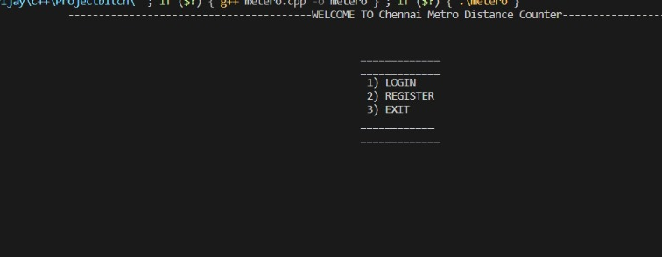
WELCOME PAGE

Slide 15
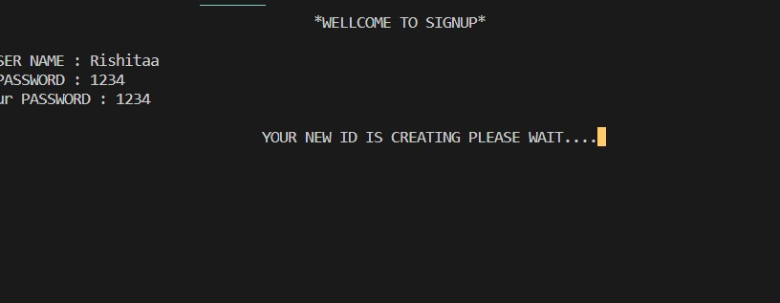
SIGN UP PAGE

Slide 16
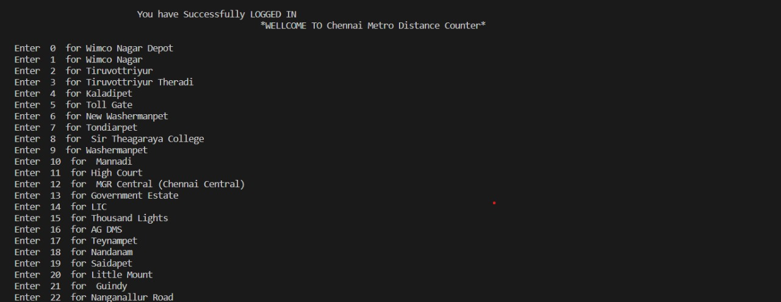
LOGIN PAGE

Slide 17
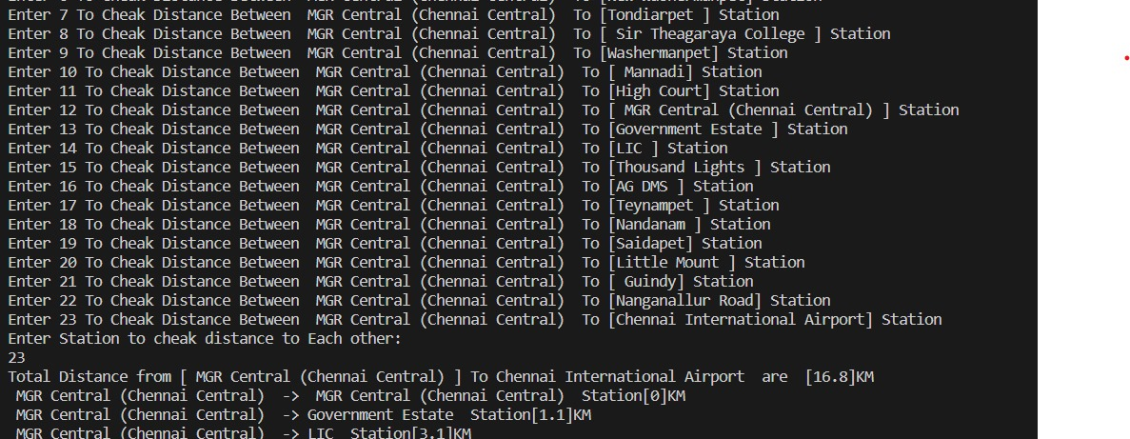
MINIMUM DISTANCES

Slide 18
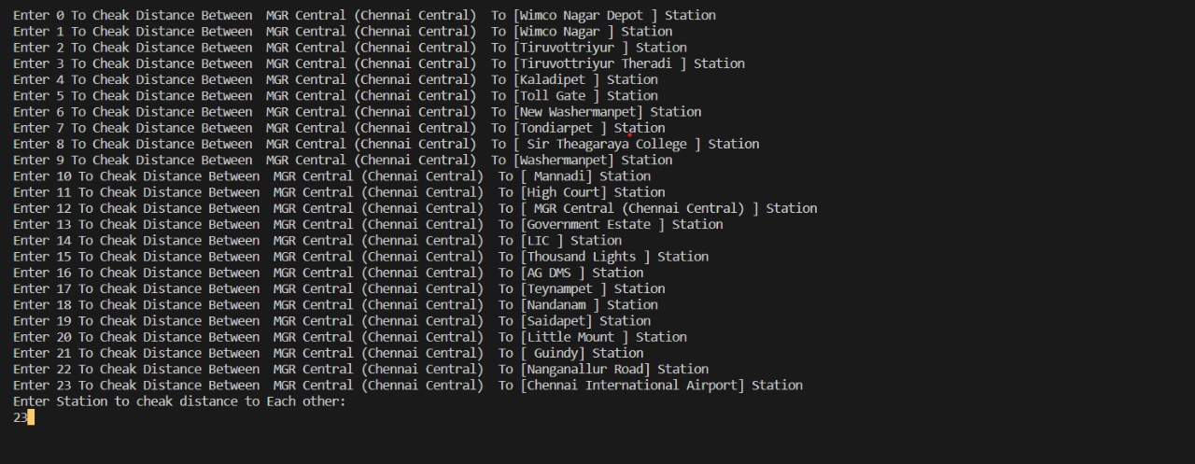
EXAMPLE OUTPUT

Slide 19
CHALLENGES FACED
Data Management:
Challenge: Managing and updating data related to metro networks, station names, coordinates, and connections can be complex, as this information may change over time.
Solution: Implement a data management system to handle station data, possibly through databases or regularly updated files.
User Authentication and Security:
Challenge: Ensuring secure user authentication and protecting user data (e.g., usernames and passwords) is critical but challenging.
Solution: Implement strong security practices, like password hashing and encryption, to protect user information.
Graph Representation:
Challenge: Representing the metro network as a weighted graph can be challenging, especially for large and complex networks.
Solution: Use efficient data structures and algorithms to represent the graph, possibly employing graph databases for scalability.
Algorithm Complexity:
Challenge: Dijkstra's algorithm is effective for finding the shortest path, but it can be computationally expensive for large networks.
Solution: Optimize the algorithm and consider alternatives, such as A* search, for more efficient route finding
WITH THEIR SOLUTIONS

Slide 20
FUTURE IMPROVEMENTS
1. Integration of Real-Time Data:
Incorporate real-time data from metro authorities or third-party APIs to provide users with up-to-the-minute information on service disruptions, delays, or station closures. This will help users make informed travel decisions
.
2. Enhanced User Preferences:
Allow users to set a wider range of preferences, such as selecting specific routes or modes of transportation (e.g., bus, tram), customizing accessibility options, and specifying travel times.
3. Multiple Transport Modes:
Extend the application to cover multiple modes of public transportation, including buses, trams, and trains. Users can then plan multimodal journeys.
4.Interactive Map Integration:
Implement interactive maps that display the metro network and selected routes. Users can visualize their journeys and explore station locations more easily.
5. Mobile Application Development:
Develop mobile applications for Android and iOS platforms to provide users with a mobile-friendly and on-the-go solution. This can include features like GPS integration for real-time location tracking.
The provided Metro Route Finder project, while serving as a starting point, can be improved in several ways to make it more robust, user-friendly, and feature-rich. Here are some future improvements that can be made to enhance the project:

